Slide 1
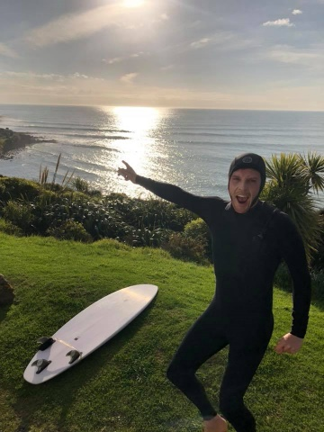
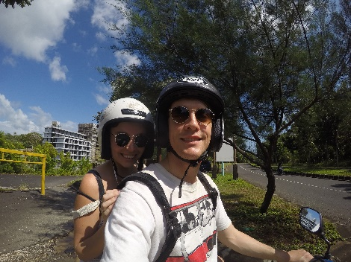
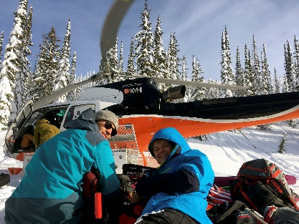
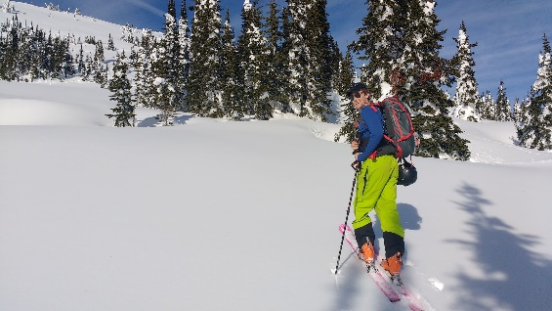
My Project Portfolio

Slide 2
Outline
Purpose
User Stories
Design Considerations
Demonstration
Favorite parts & lessons learned
Question time
Notes:
A walk-through of your live app and its features
A review of your build process including challenges, ethical issues, favourite parts, etc
Answer questions from the audience

Slide 3
My objectives
ENABLE
Visitors to easily locate my projects and related media
DEMONSTRATE
My web development abilities and growth trajectory
SHARE
Information about my personality and ambitions
COMMUNICATE
Previous experience and education

Slide 4


User Stories
I’m Tom,
I want to see Billy’s passions, so that….
I can tell if he will give a crap about my pro-bono project.
I’m Sally,
I want a link to Billy’s resume, so that….
I can send it straight to the CEO.
I’m Alex,
I want to see what tools Billy is familiar with, so that….
I won’t have to invest lots of time training him in html.
I’m Jess,
I want to see Billy’s Twitter profile, so that….
I can tell if will be a good cultural fit for my organisation.
I’m Rowina,
I want to see Billy’s projects, so that….
I can see if he has solved a similar problem I need assistance with.
I’m Charles,
I want to see Billy’s hobbies, so that….
I can tell if he will be someone I’d enjoy having a beer with after work.

Slide 5
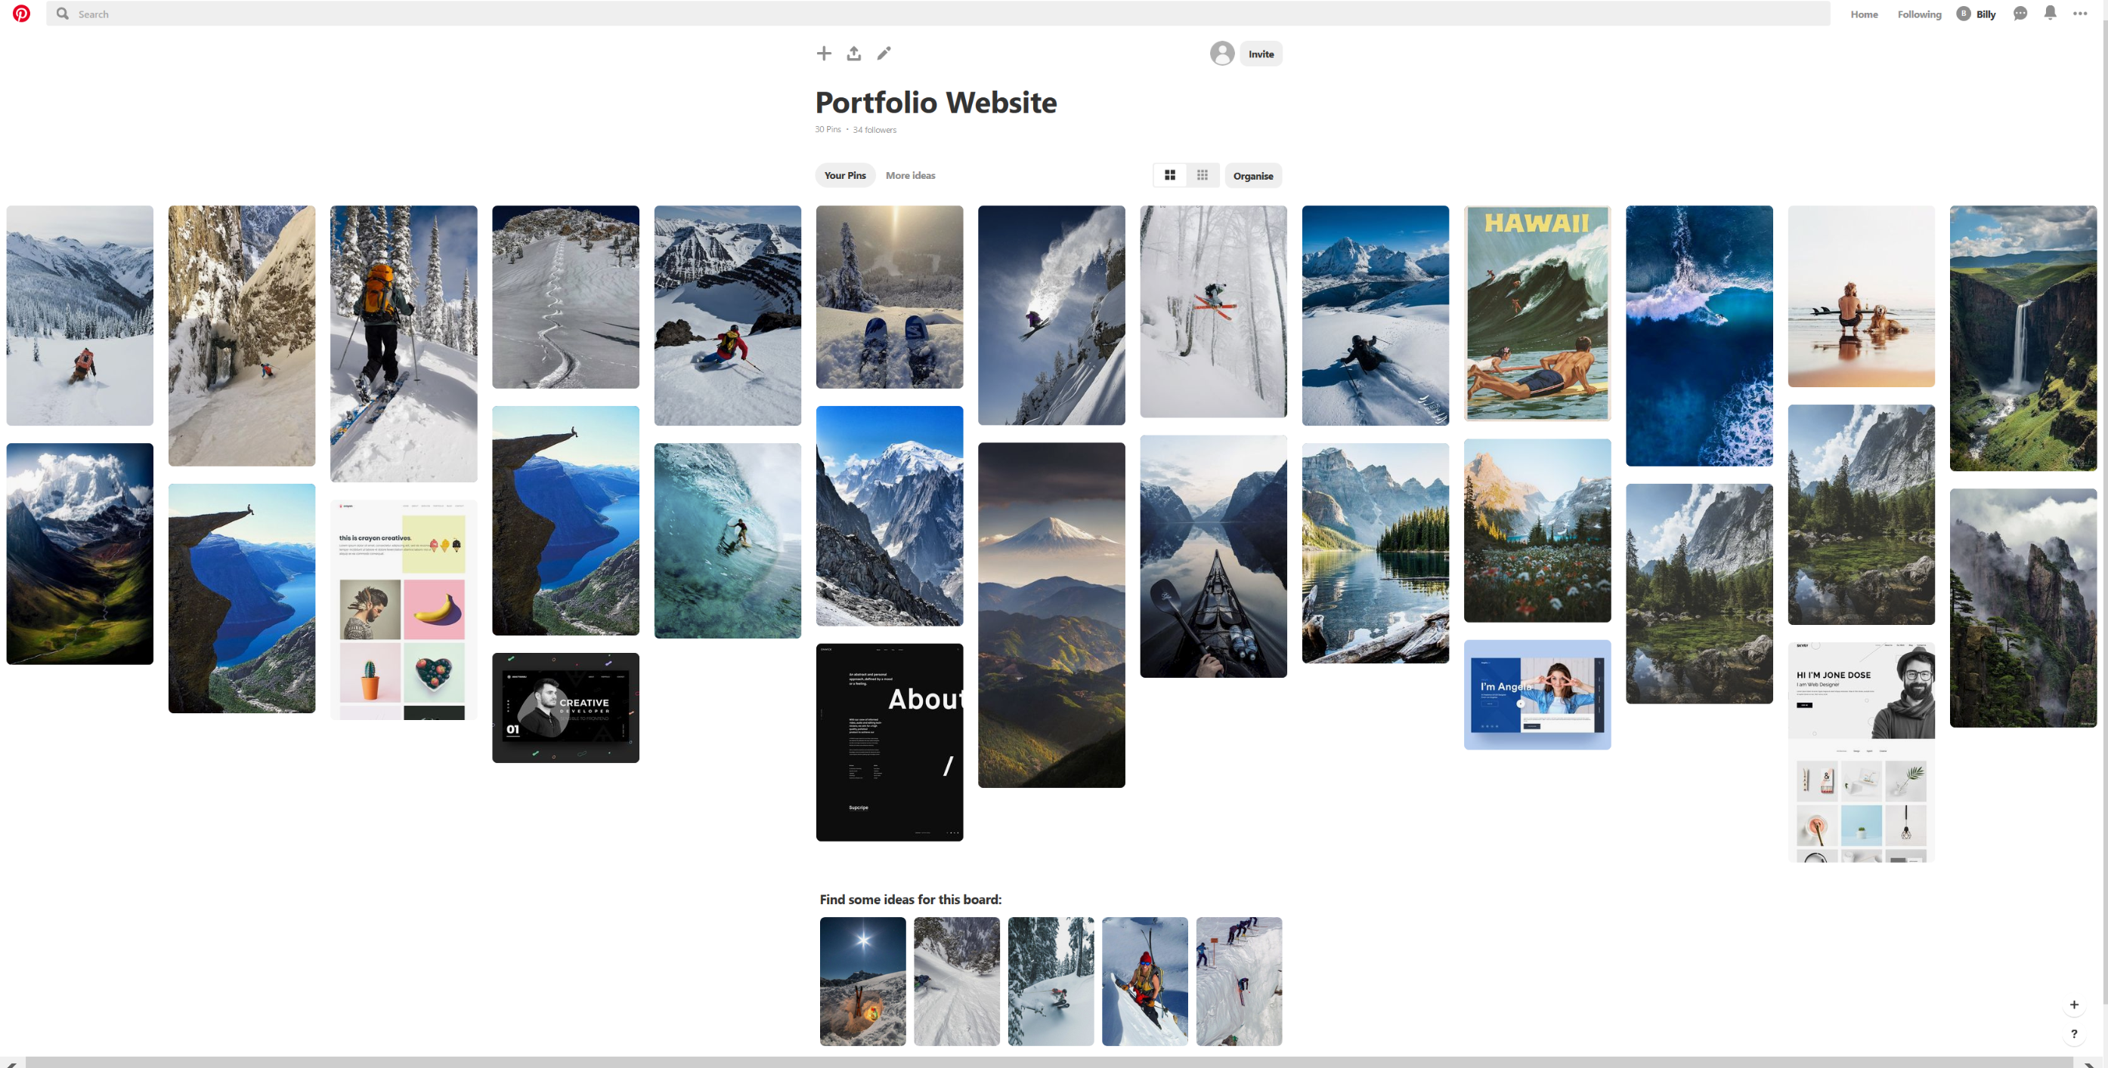
Design Overview
MOOD BOARD
Considerations
Reflect my love of nature and outdoors
Green, brown and white colors
Emphasize and focus content by using whitespace
Consistency of styling across the page
Use of cards
A single font

Slide 6
Lessons Learned
Fun bits
Lessons learned
Learning Flex Box and understanding it’s power!
Researching award winning portfolios (and CSS potential)
Learning a smidge of Javascript to implement click functionality on nav bar
Be careful setting fixed heights and widths for images
Look out for blocks within in-line elements
Wireframe multiple screen sizes

Slide 7
Questions?

